Slide 1
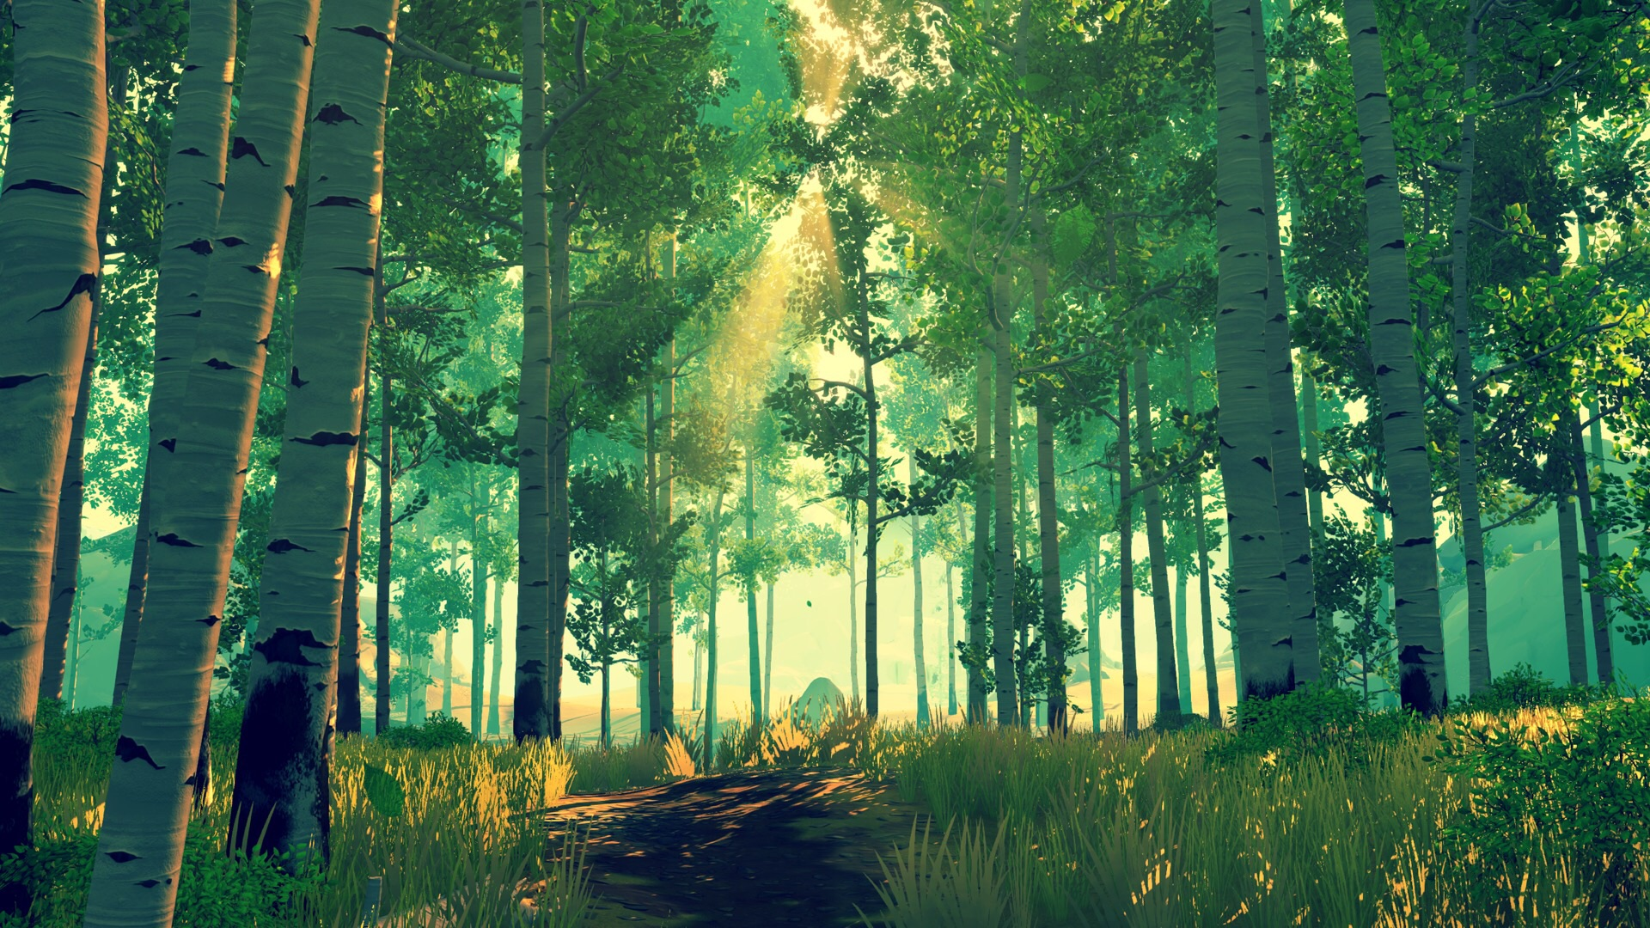
Failing Grounds
SAVE THE TREES
SAVE THE TREES
Failing Grounds

Slide 2
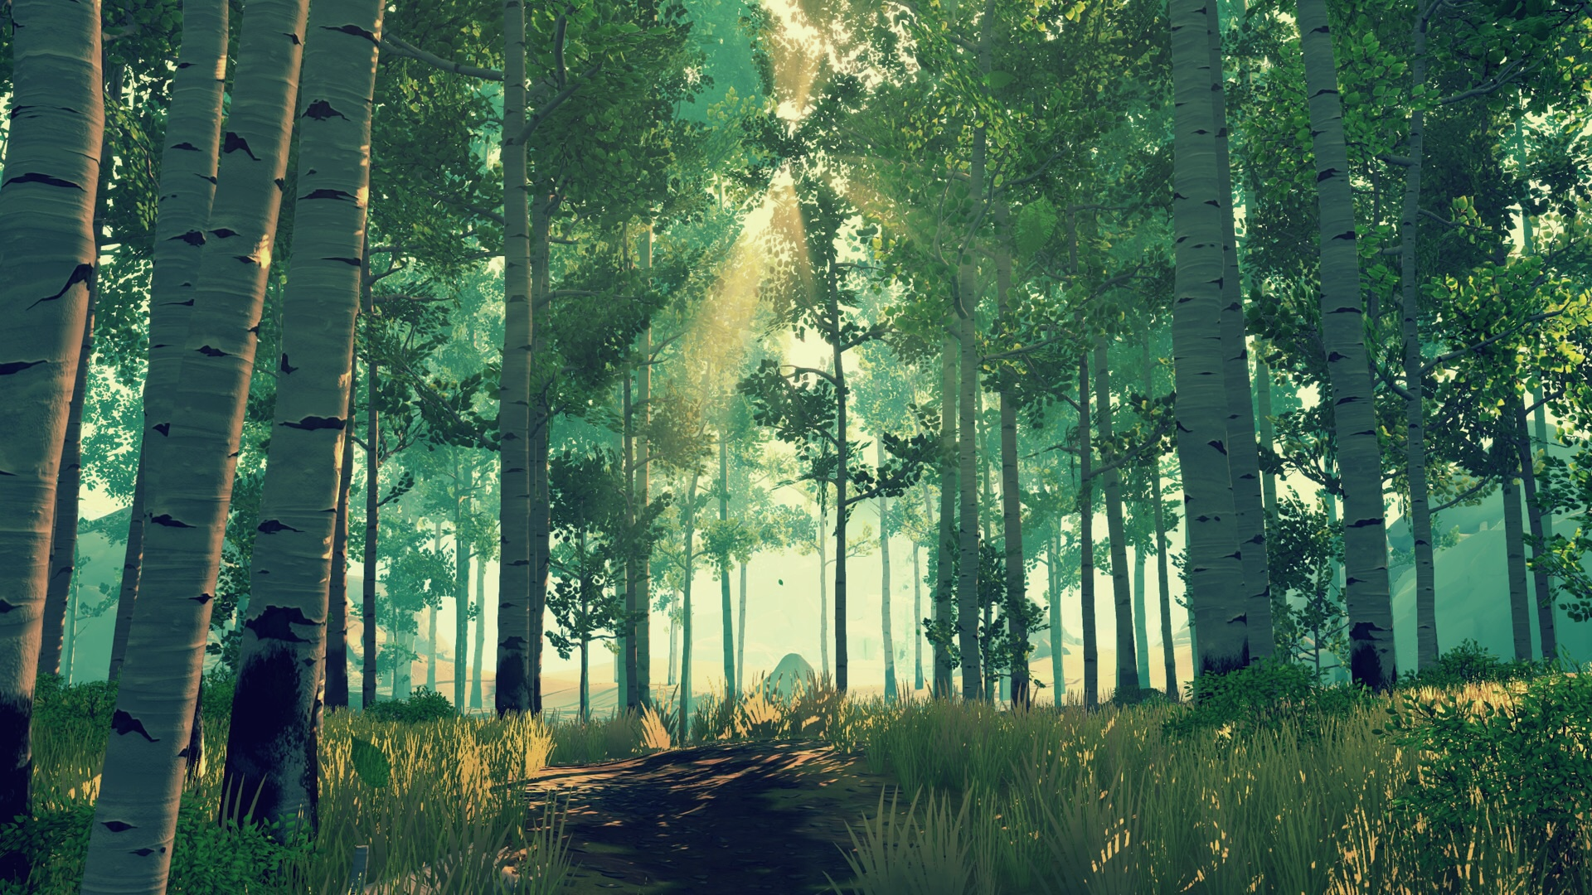
Inleiding
Concept
Style Guide
Functioneel Ontwerp
Technisch Ontwerp
Organisatie
Planning
Inleiding

Slide 3
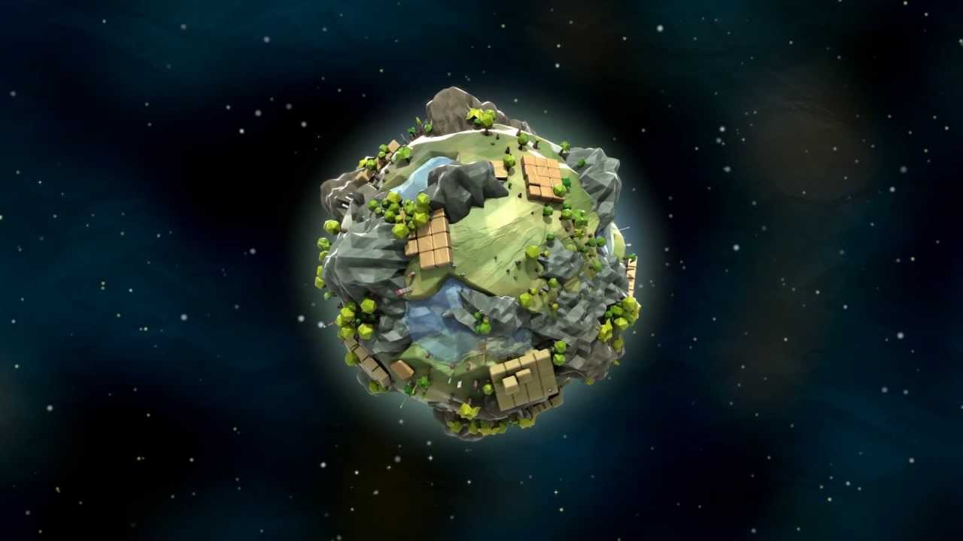
Concept
Doel
Scope
Progression
Concept

Slide 4

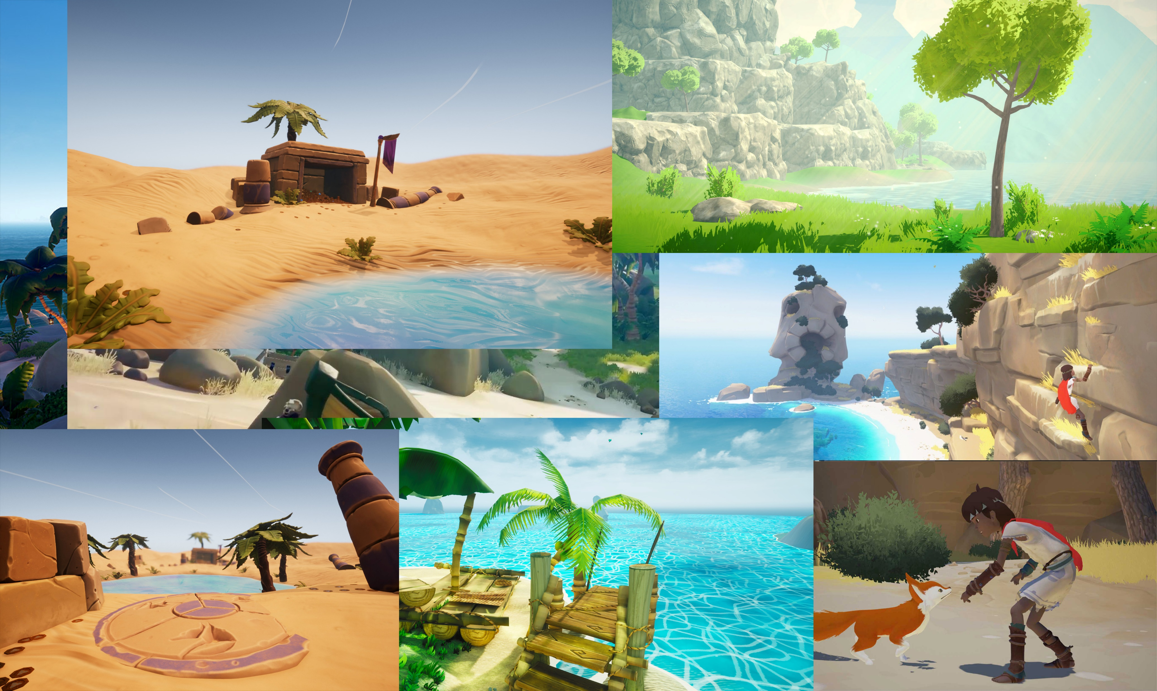
ArtStyle
Inspiratie
Setting
Style Guide
Style Guide

Slide 5
Poly Count
Texture Resolution
Amount Of Detail
Resource Budget
Resource Budget

Slide 6
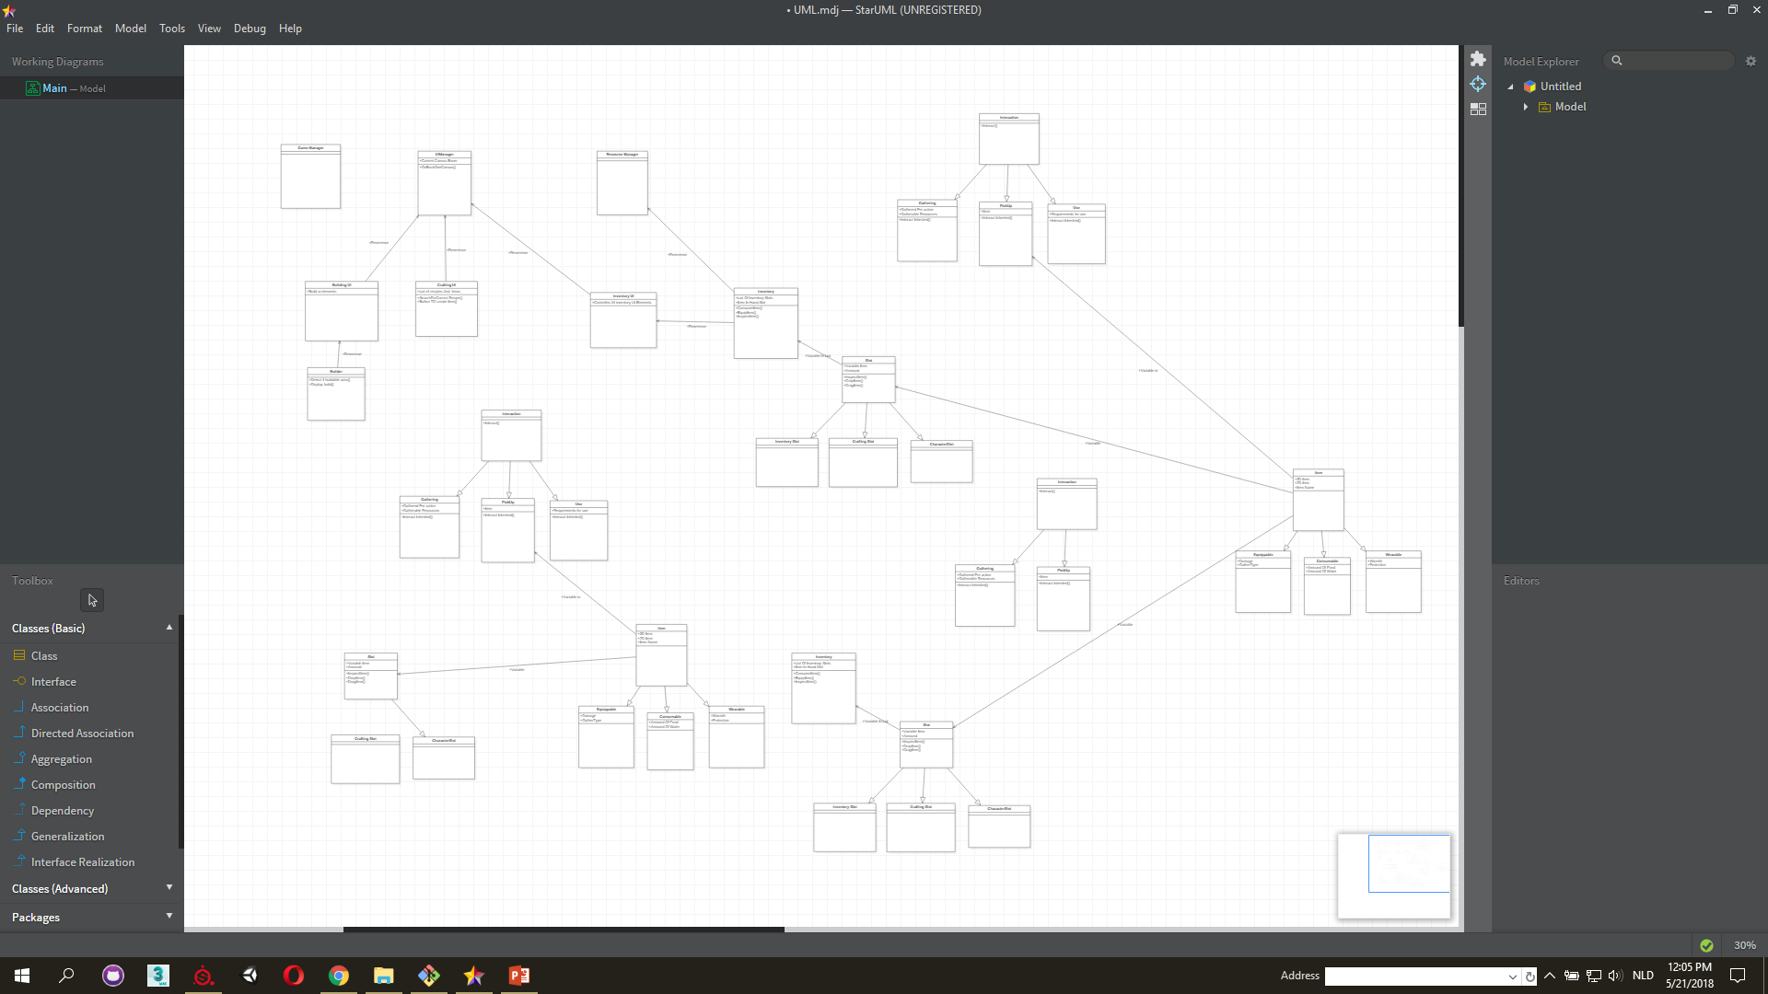

Camera Movement
Player MovementPlayer Abilities
GUI
Level Design
Enemies
Technisch
Ontwerp
Technisch
Ontwerp

Slide 7

Naming Conventions
Repository
Sources
Organisatie
Organisatie

Slide 8
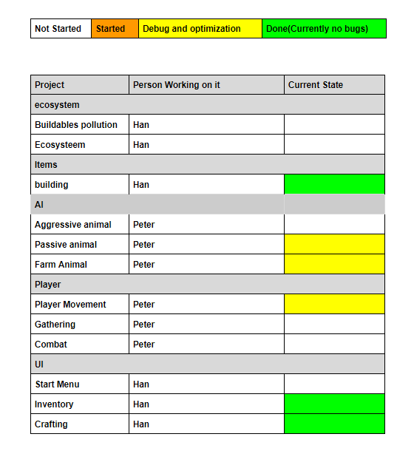
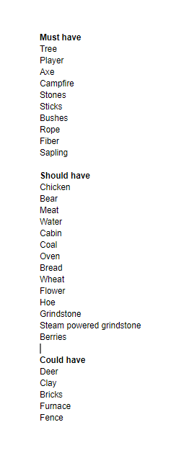
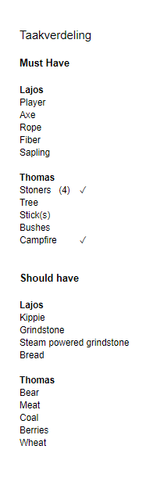
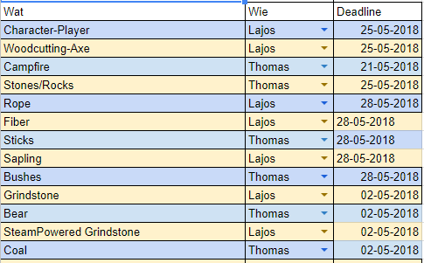
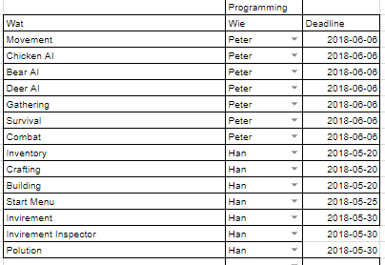
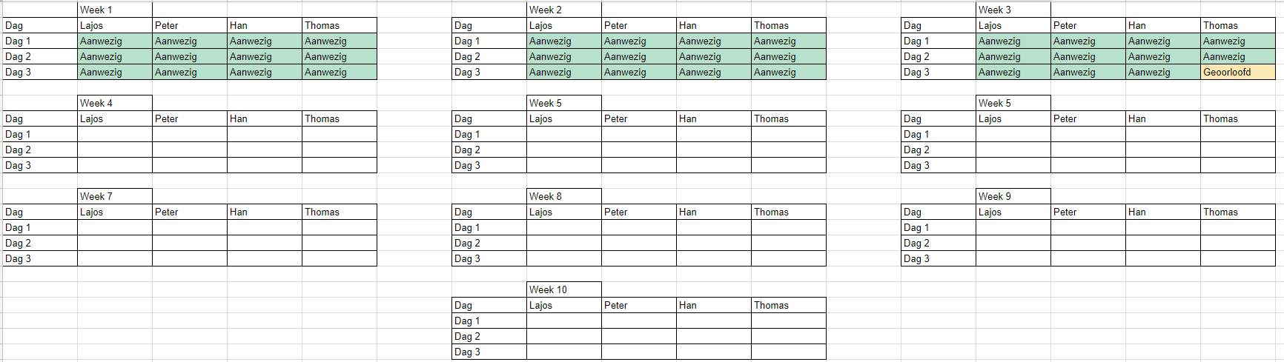
Rolverdeling
Uren Planning
Aanwezigheid
Planning
Planning

Slide 9


